Slide 1
JUnits and Mockito

Slide 2
What is JUnit?
JUnit is a testing framework for Java
It is a simple framework to write repeatable tests
A test case is a program written in Java
JUnit helps the programmer:
Define and execute tests and test suites
Formalize requirements and clarify architecture
Write and debug code
Test source code automatically
Integrate code and always be ready to release a working version
Notes:
A unit test tests the methods in a single class

Slide 3
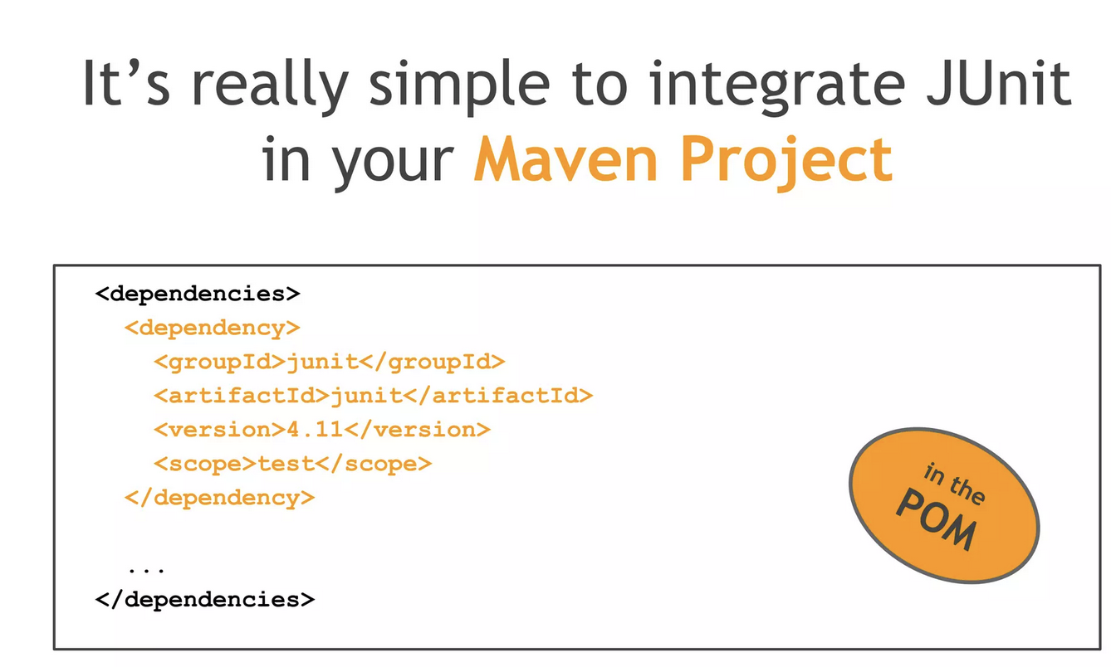

Slide 4
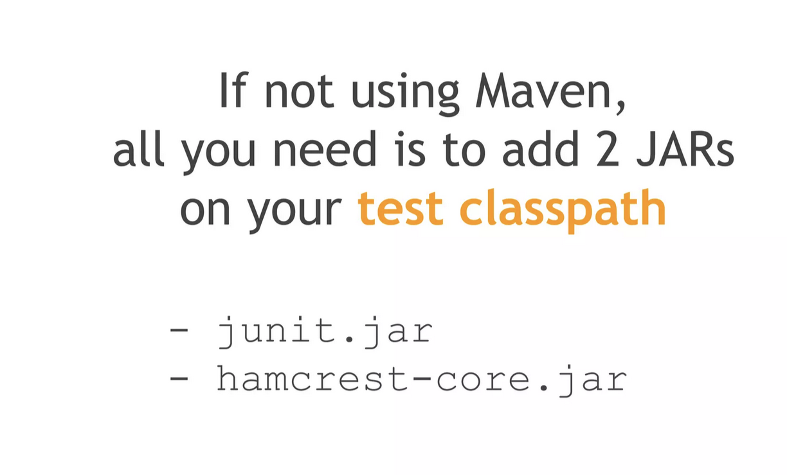

Slide 5
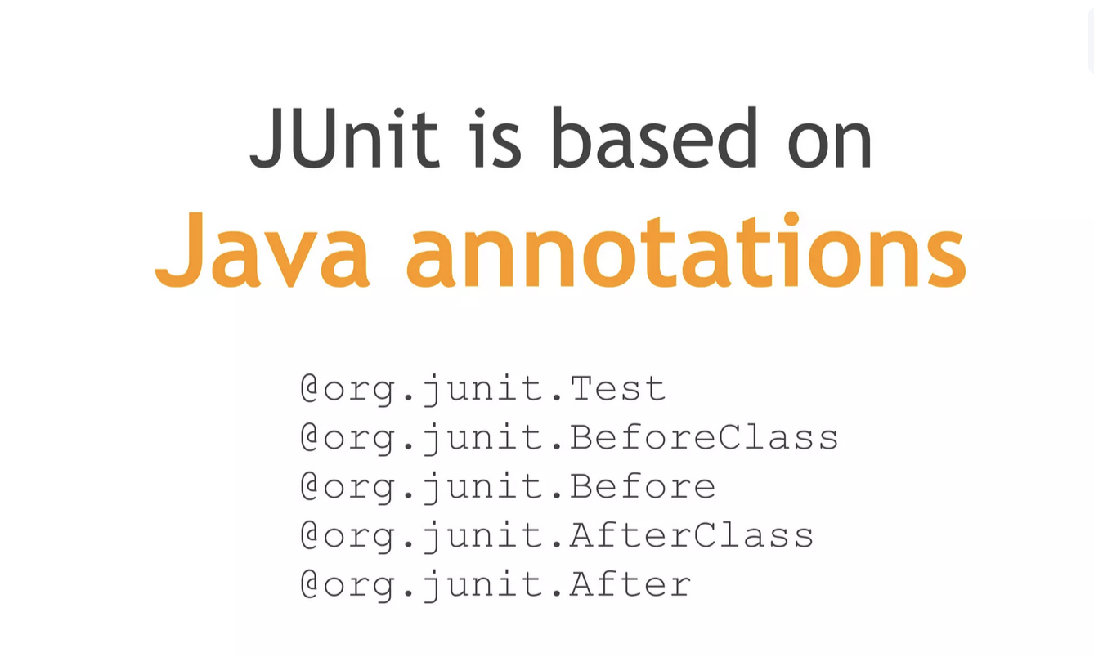

Slide 6
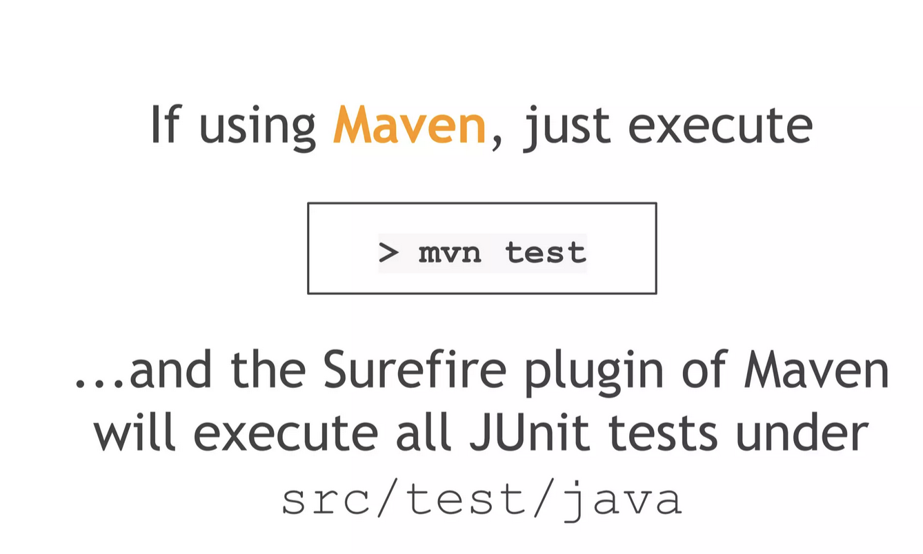

Slide 7
Writing a JUnit test class
Start by importing these JUnit 5 classes:
import org.junit.*; import static org.junit.Assert.*; // note static import
Declare your test class in the usual way
public class MyProgramTest {
…
}

Slide 8
Writing a JUnit test class
Declare an instance of the class being tested
You can declare other variables, but don’t give them initial values here
public class MyProgramTest { MyProgram program; int someVariable;
…
}

Slide 9
Writing a JUnit test class
Define a method (or several methods) to be executed before each test
Initialize your variables in this method, so that each test starts with a fresh set of values
@Before public void setUp() { program = new MyProgram(); someVariable = 1000; }

Slide 10
Writing a JUnit test class
You can define one or more methods to be executed after each test
Typically such methods release resources, such as files
Usually there is no need to bother with this method
@After public void tearDown() { }

Slide 11
Example – Class calculator
CalculatorTest.java import junit.framework.Assert; import org.junit.Test; public class CalculatorTest {
Calculator calculator = new Calculator();
@Test public void testSum() { int result = calculator.sum(2, 2); if (result != 4) { Assert.fail(); } } @Test public void testMinus() { Assert.assertEquals(0, calculator.minus(2, 2)); } @Test public void testDivide() { Assert.assertEquals(2, calculator.divide(6, 3)); } @Test(expected = ArithmeticException.class) public void testDivideWillThrowExceptionWhenDivideOnZero() { calculator.divide(6, 0); } }
Add Dependency in pom.xml
<dependency> <groupId>junit</groupId> <artifactId>junit</artifactId> <version>4.8.1</version> </dependency>
Calculator.java
public class Calculator { public int sum(int a, int b) { return a + b; } public int minus(int a, int b) { return a - b; } public int divide(int a, int b) { return a / b; } public int multiply(int a, int b) { return a * b; } }

Slide 12
JUnit annotations
The following table gives an overview of the available annotations in JUnit 4.x.
Annotation | Description
@Test public void method() | The @Test annotation identifies a method as a test method.
@Test (expected = Exception.class) | Fails, if the method does not throw the named exception.
@Test(timeout=100) | Fails, if the method takes longer than 100 milliseconds.
@Before public void method() | This method is executed before each test. It is used to can prepare the test environment (e.g. read input data, initialize the class).

Slide 13
JUnit annotations
Annotation | Description
@After public void method() | This method is executed after each test. It is used to cleanup the test environment (e.g. delete temporary data, restore defaults). It can also save memory by cleaning up expensive memory structures.
@BeforeClass public static void method() | This method is executed once, before the start of all tests. It is used to perform time intensive activities, for example to connect to a database. Methods annotated with this annotation need to be defined asstatic to work with JUnit.
@AfterClass public static void method() | This method is executed once, after all tests have been finished. It is used to perform clean-up activities, for example to disconnect from a database. Methods annotated with this annotation need to be defined as static to work with JUnit.
@Ignore | Ignores the test method. This is useful when the underlying code has been changed and the test case has not yet been adapted. Or if the execution time of this test is too long to be included.

Slide 14
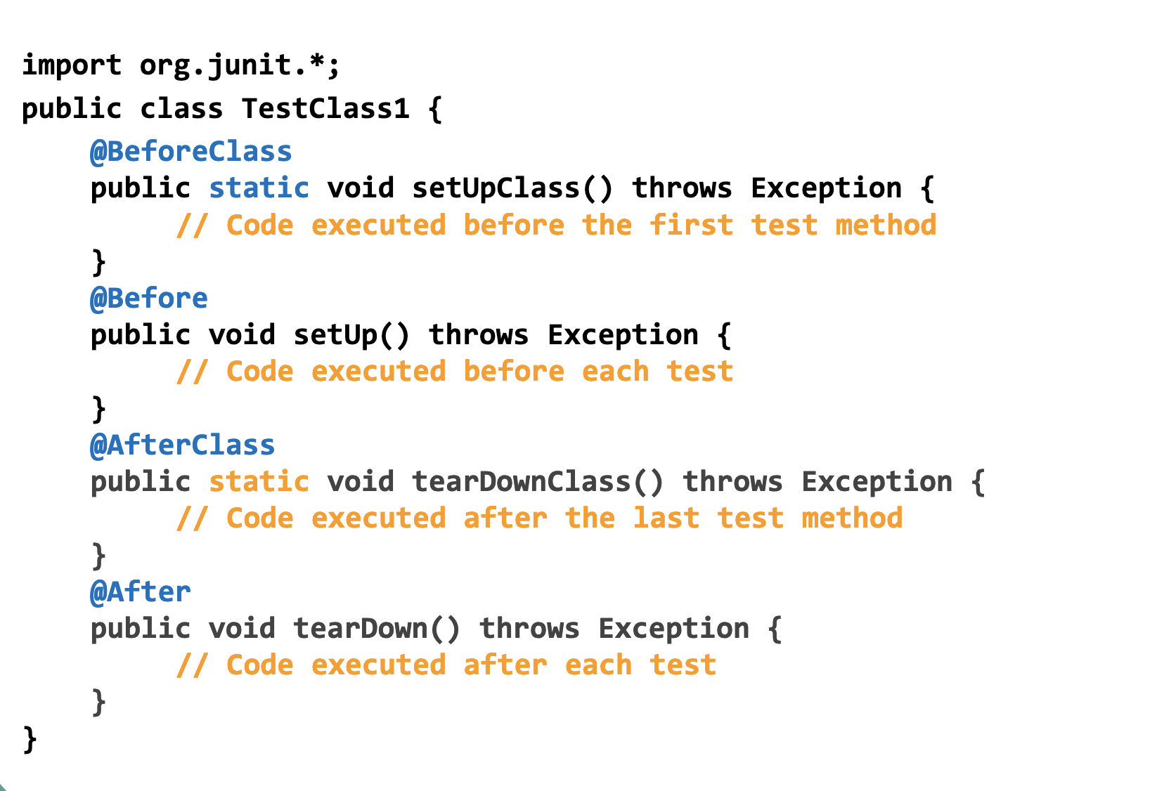

Slide 15
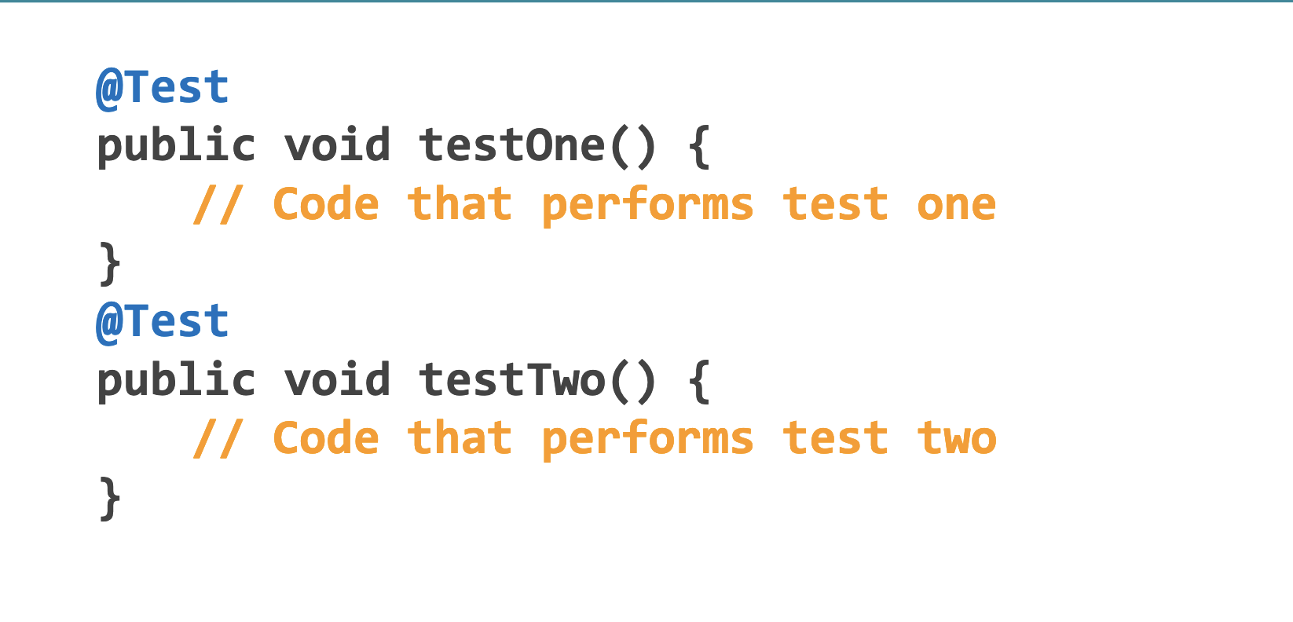

Slide 16
JUnit assertions
JUnit provides assertion methods for all primitive types and
Objects and arrays
In these methods the expected value is compared with the
actual value.
The parameter order is:
▪ expected value
▪ actual value

Slide 17
Assert statements
Statement | Description
fail(String) | Let the method fail. Might be used to check that a certain part of the code is not reached. Or to have a failing test before the test code is implemented. The String parameter is optional.
assertTrue([message], boolean condition) | Checks that the boolean condition is true.
assertFalse([message], boolean condition) | Checks that the boolean condition is false.
assertEquals([String message], expected, actual) | Tests that two values are the same. Note: for arrays the reference is checked not the content of the arrays.

Slide 18
Assert statements
Statement | Description
assertEquals([String message], expected, actual, tolerance) | Test that float or double values match. The tolerance is the number of decimals which must be the same.
assertNull([message], object) | Checks that the object is null.
assertNotNull([message], object) | Checks that the object is not null.
assertSame([String], expected, actual) | Checks that both variables refer to the same object.
assertNotSame([String], expected, actual) | Checks that both variables refer to different objects.

Slide 19
Special features of @Test
You can limit how long a method is allowed to take
This is good protection against infinite loops
The time limit is specified in milliseconds
The test fails if the method takes too long
@Test (timeout=10) public void greatBig() { assertTrue(program.ackerman(5, 5) > 10e12); }

Slide 20
Special features of @Test
Some method calls should throw an exception
You can specify that a particular exception is expected
The test will pass if the expected exception is thrown, and fail otherwise
@Test (expected=IllegalArgumentException.class) public void factorial() { program.factorial(-5); }

Slide 21
Ignoring a test
The @Ignore annotation says to not run a test
@Ignore("I don’t want Dave to know this doesn’t work") @Test public void add() { assertEquals(4, program.sum(2, 2)); }
You shouldn’t use @Ignore without a very good reason!
@Ignore can be used for class to ignore the whole test class

Slide 22
Mockito

Slide 23
Mockito for mocking objects
Mockito is a Java framework allowing the creation of mock
objects in automated unit tests objects in automated unit tests.
A mock object is a dummy implementation for an interface or a class in which you define the output of certain method calls.
class in which you define the output of certain method calls.
Mockito is a popular mock framework which can be used in conjunction with JUnit.
Mockito allows you to create and configure mock objects.
Mockito supports the creation of mock objects with the static mock() method call.
It also supports the creation of mock objects based on the @Mock annotation.
Notes:
]

Slide 24
The Need for Mocks
Mocking is the act of removing external dependencies from a unit test in order to create a controlled environment around it. Typically, we mock all other classes that interact with the class that we want to test. Common targets for mocking are:
Database connections,
Web services,
Classes that are slow,
Classes with side effects, and
Classes with non-deterministic behavior.

Slide 25
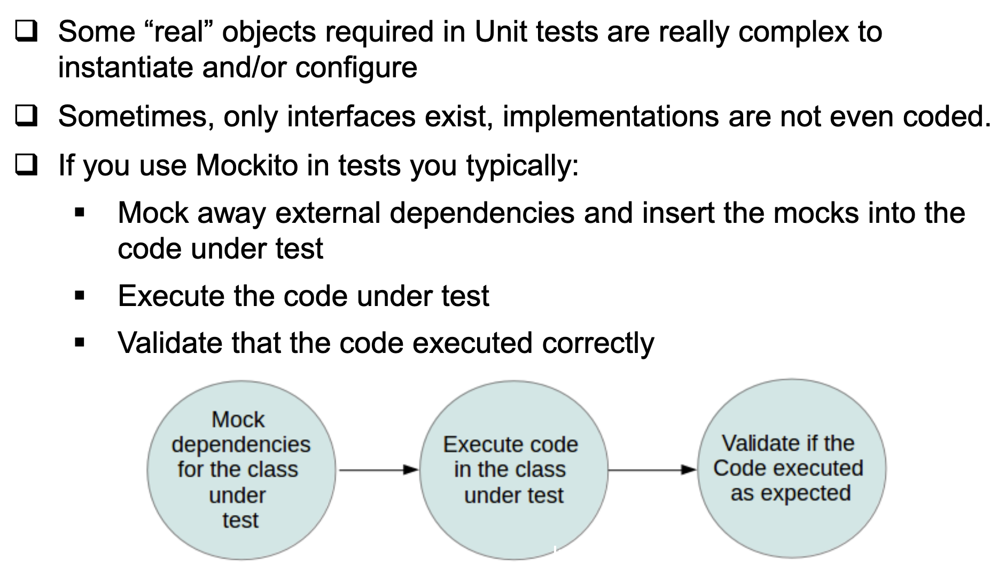
Why Mockito?

Slide 26
Imagine you're testing a service that calculates discounts for customers. This service might rely on another service to fetch customer data. Using Mockito, you can mock the customer data service to return specific data, allowing you to test how your discount service behaves without needing access to the real customer data service.
The best solution for a true unit test is to completely remove the database dependency. We will stub the database connection instead, and “fool” our class to think that it is talking to a real EntityManager, while in reality, the EntityManager is a Mockito stub. This way, we have complete control over what is returned by the database connection without having to deal with an actual database.

Slide 27
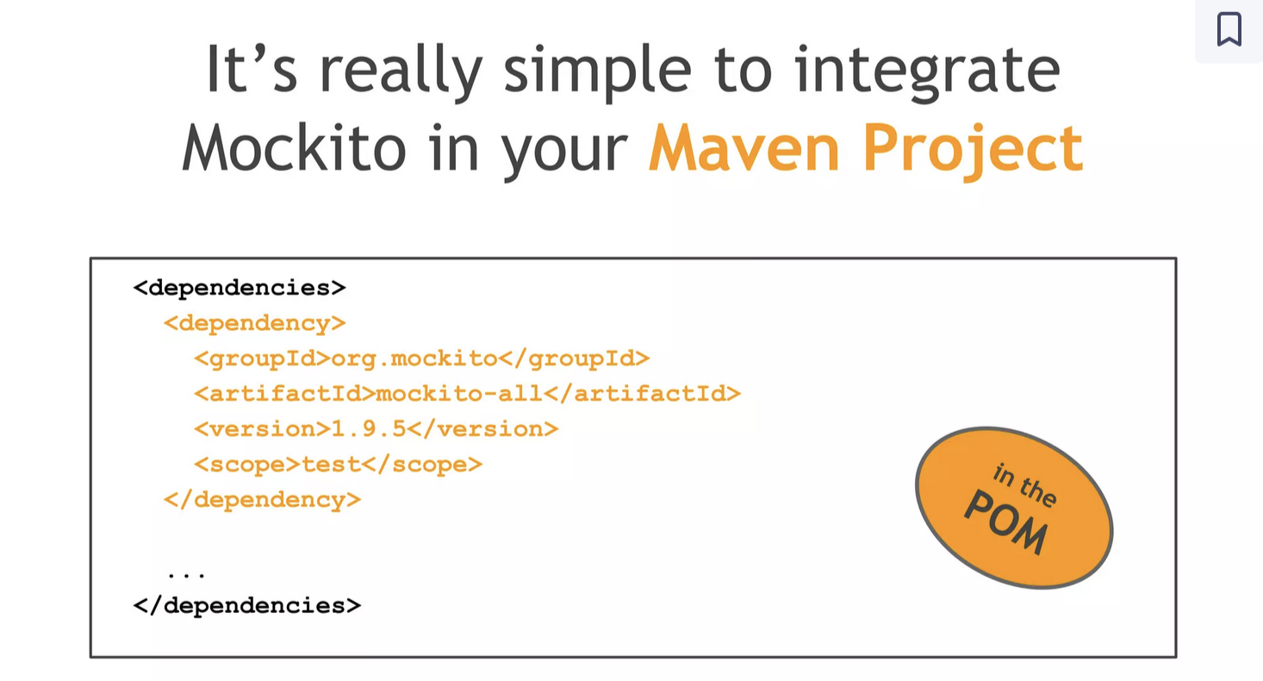

Slide 28
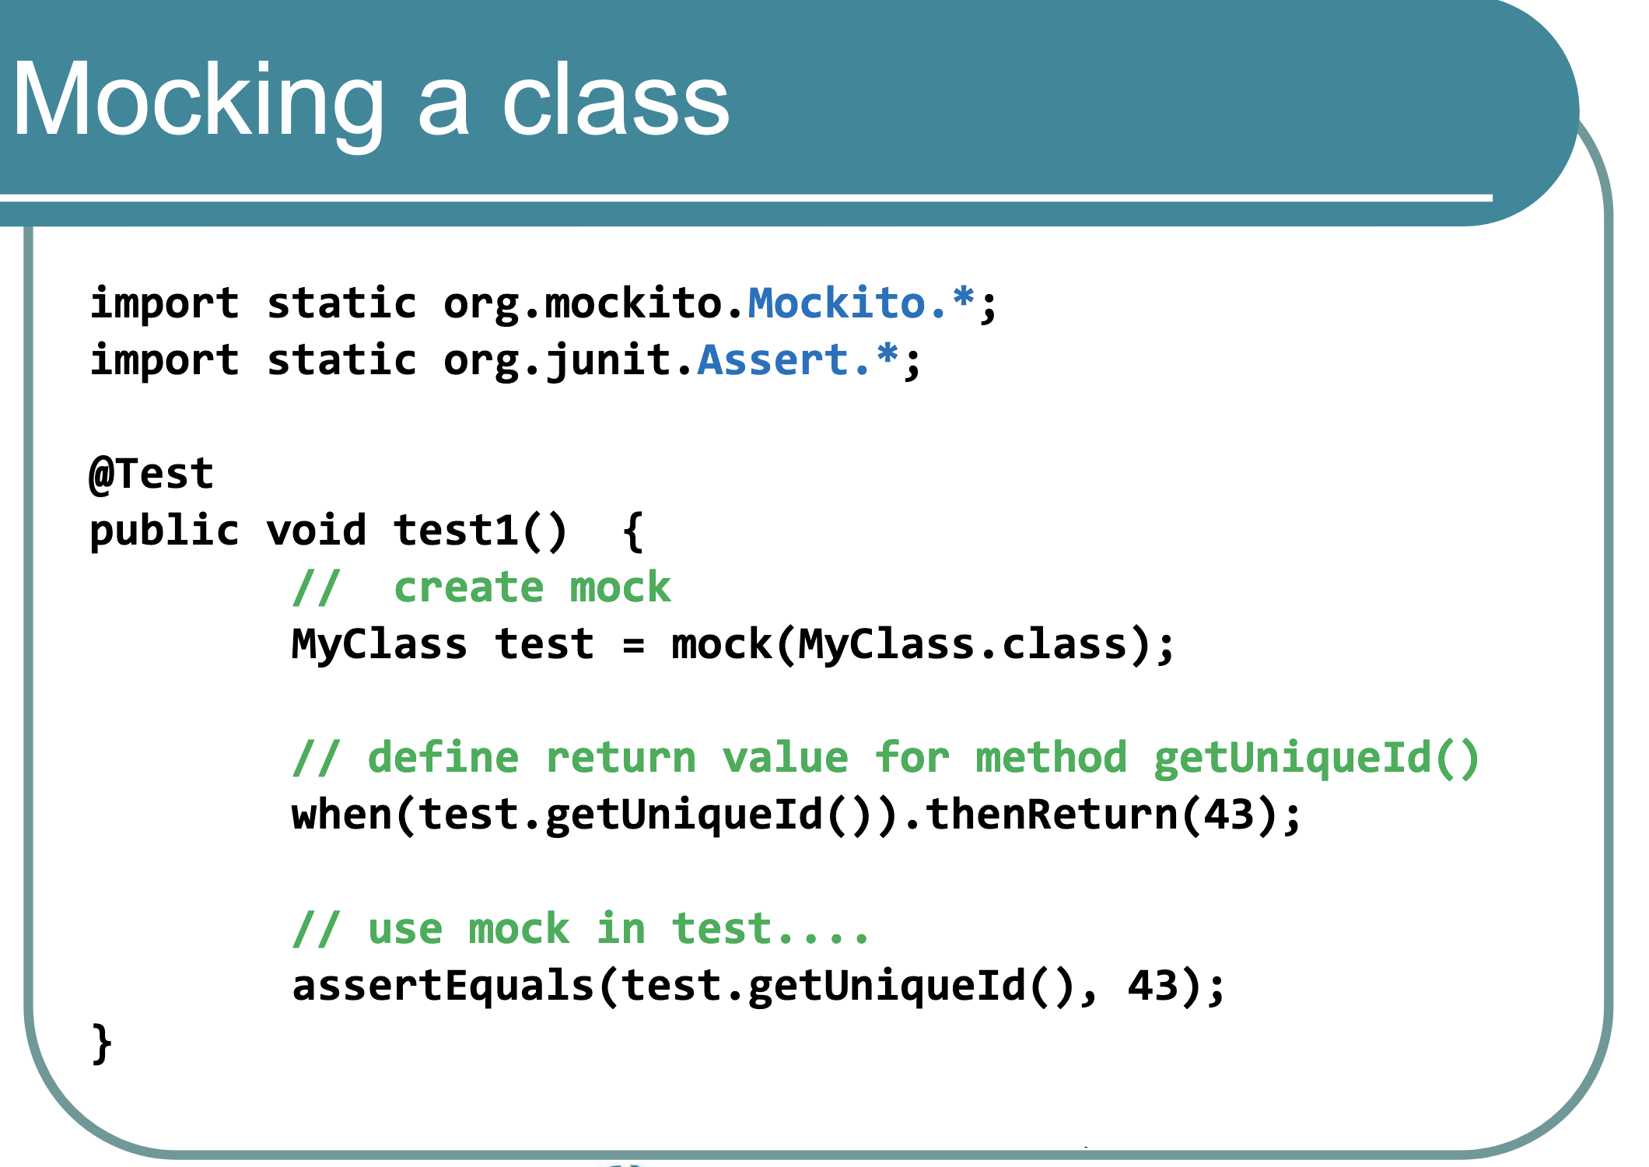

Slide 29
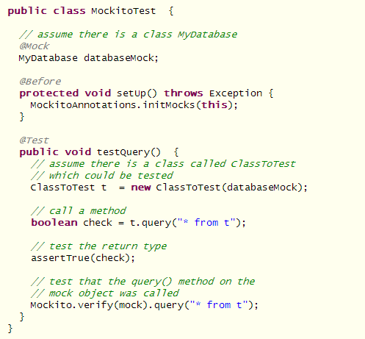
Using Mockito

Slide 30
Limitations
Mockito has certain limitations. It can not test the following constructs:
Final classes
Primitive types

Slide 31
Configuring the mock objects
Mockito has a fluent API. You can use the verify() method to ensure that a method was called.
when(....).thenReturn(....) can be used to specify a condition and a return value for this condition.

Slide 32
Configuring the mock objects
@Test
public void test1 ( ) {
MyClass test = Mockito.mock(MyClass.class);
// Define return value for method getUniqueId( )
test.when(test.getUniqueId( )).thenReturn(43);
// TODO use mock in test…
}

Slide 33
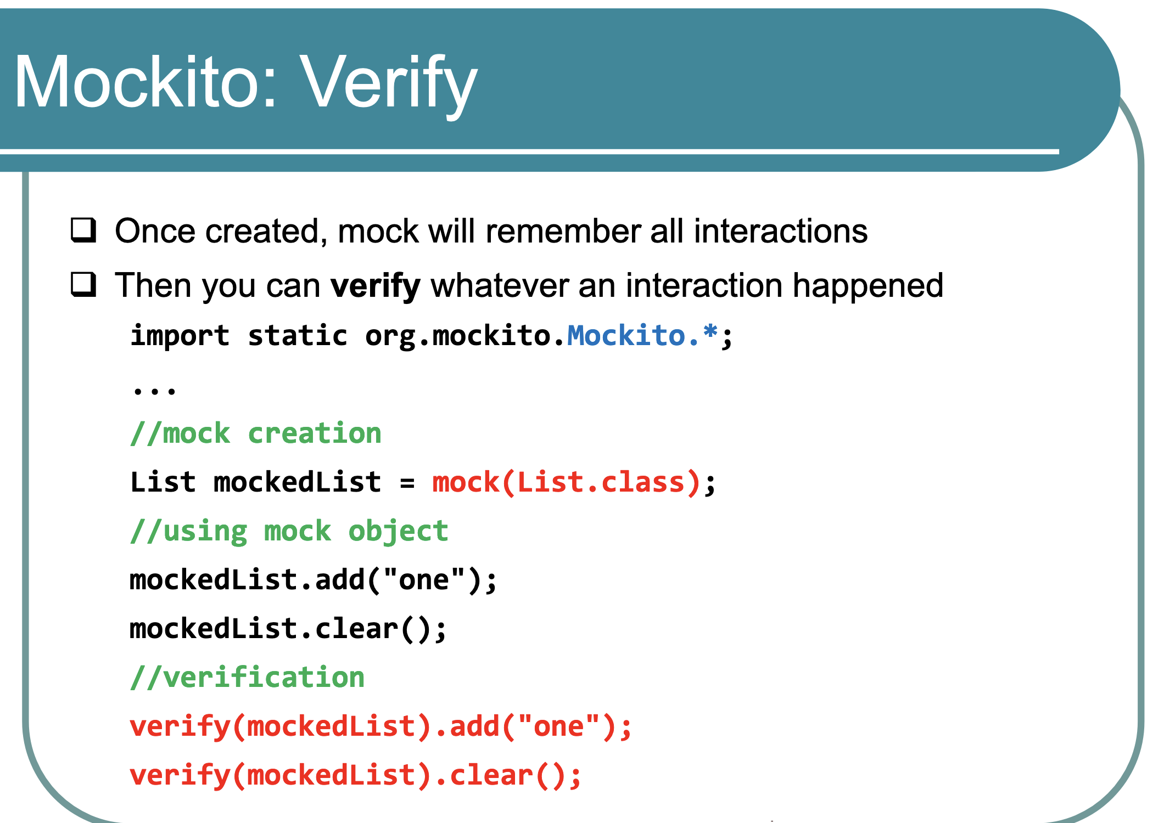

Slide 34
Verify the calls on the mock objects
@Test
public void test1 ( ) {
MyClass test = Mockito.mock(MyClass.class);
// Define return value for method getUniqueId( )
test.when(test.getUniqueId( )).thenReturn(43);
// TODO use mock in test…
// Now check if method testing was called with the parameter 12
Mockito.verify(test).testing(Matchers.eq(12));
// Was the method called twice?
Mokito.verify(test, Mokito.times(2));
}

Slide 35
Verify the calls on the mock objects
Note
This kind of testing is sometimes called behavior testing, because it does not check the result of a method call, but it checks that a method is called with the right parameters.

